Slide 1

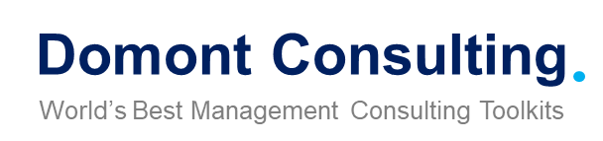
Management Consulting Toolkit
Overview

Slide 2
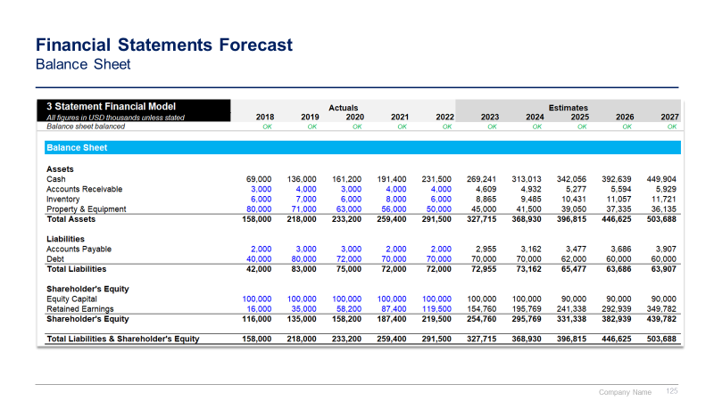
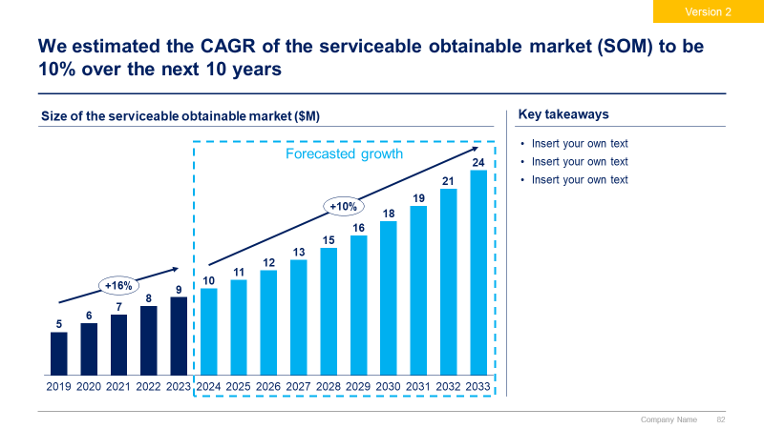
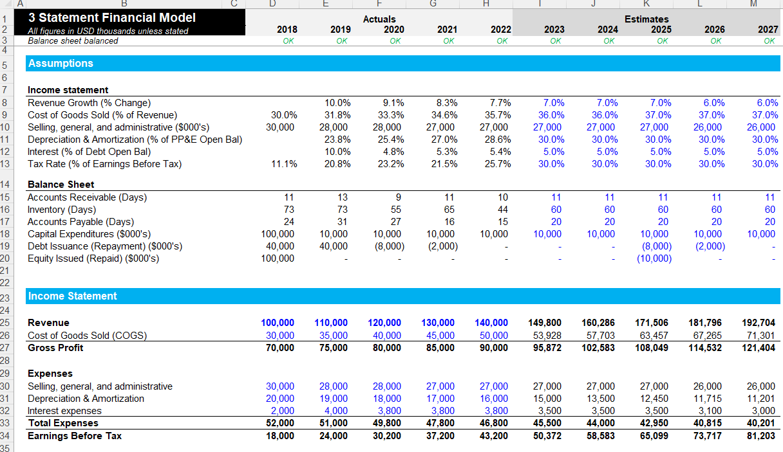
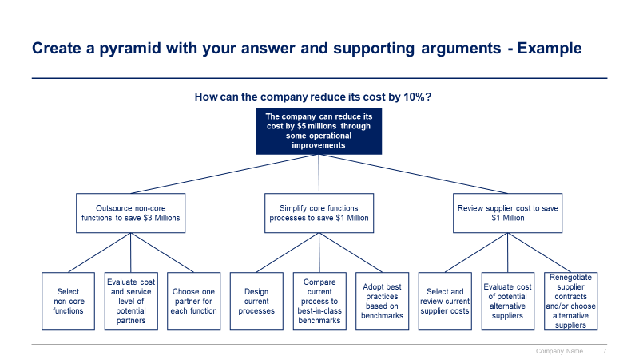
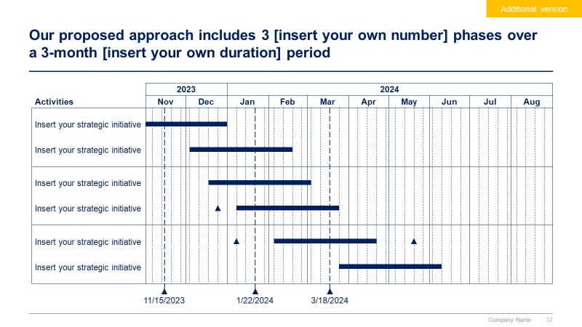
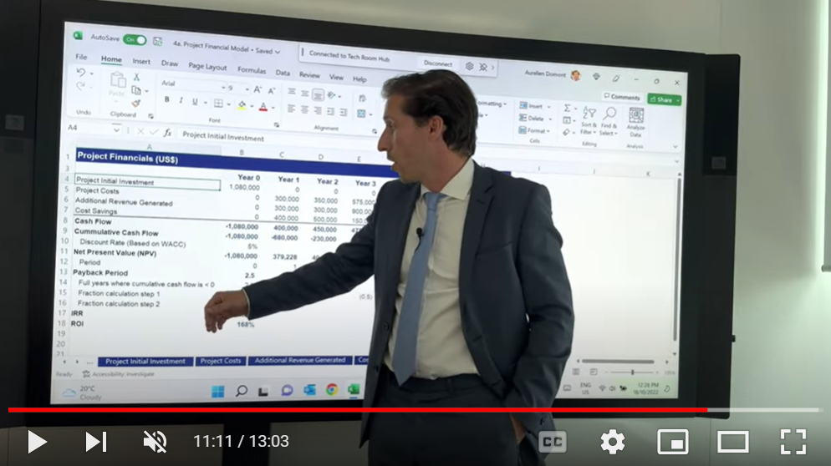
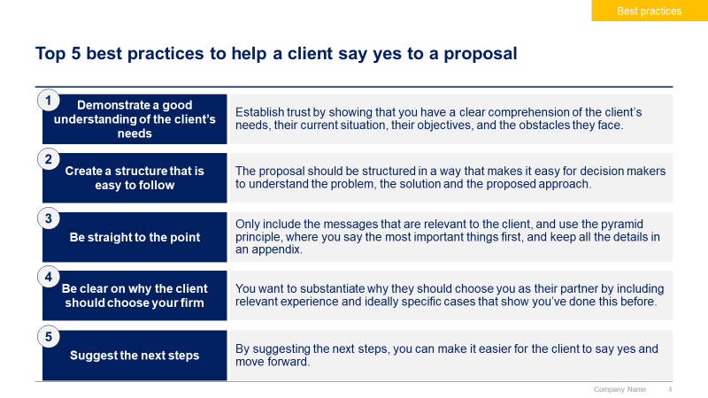
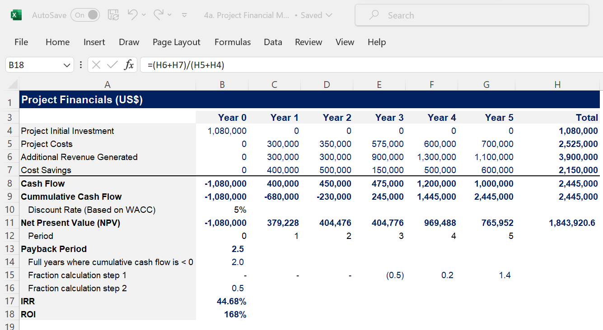
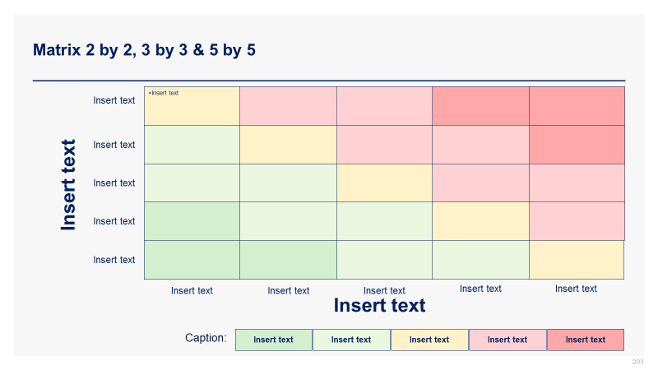
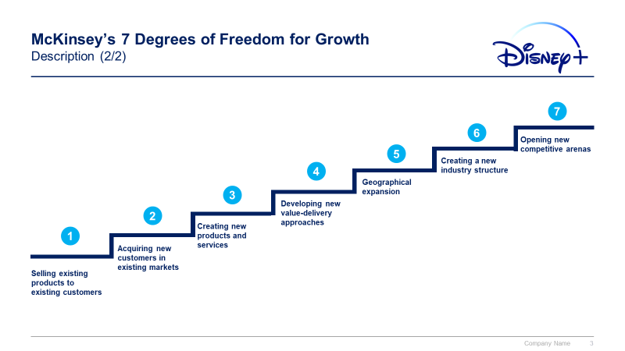

Slide 3


Introduction
This Toolkit was created by ex-McKinsey, Deloitte & BCG Consultants, after 4,000+ hours of work. It is considered the world's best & most comprehensive Management Consulting Toolkit. It includes all the Frameworks, Best Practices & Templates required to launch a management consulting practice and excel as a Management Consultant.
Join the 200,000+ Executives, Consultants & Entrepreneurs who are already leveraging our Management Consulting Toolkits to improve the performance of their organization and boost their own career.
If you have any questions, send us an email at support@domontconsulting.com and one of our ex-McKinsey, Deloitte & BCG Management Consultants will get back to you within 2 business days.
Aurelien Domont
Management Consultant
Domont Consulting Managing Director

Slide 4












Our firm created a Management Consulting Toolkit to help you launch a consulting practice and excel as a Management Consultant
What’s inside the Toolkit?
Who created the Toolkit?
The Toolkit was created by ex-McKinsey, Deloitte & BCG Management Consultants.
Best Practices
Frameworks
Number of professionals leveraging our Toolkits
Advice from
tier-1 Management Consultants
Tools
There are 200,000+ Executives, Consultants & Entrepreneurs leveraging our Toolkits to improve the performance of their organization
Real-life Examples
Templates
Trusted by small and large organizations
Video Training
Step-by-step Tutorials

Slide 5
Our Toolkit will help you fulfill multiple objectives
The Management Consulting Toolkit includes frameworks, tools, templates, tutorials, real-life examples, video training, and best practices to help you:
Launch a consulting practice and excel as a Management Consultant with our 5-phase approach: (I) Create a business plan for your consulting practice, (II) Create your consulting proposal and legal agreements, (III) Identify your client’s problem, (IV) Find a solution using world-class frameworks & Tools, (V) Present effectively.
(I) Create a business plan for your consulting practice: (1) Business plan canvas, (2) Problem to solve and solution, (3) Mission, vision and values, (4) Strategic objectives, (5) Market analysis, (6) Competitor analysis, (7) Marketing plan, (8) Business structure, (9) Financial plan, (10) Business valuation, (11) Next steps.
(II) Create your consulting proposal and legal agreements: (1) Consulting proposal: Situation and key challenge, Proposed solution, Business case and financial model, Approach, Our value proposition, Proposed team, Consulting fees, Next steps, (2) Legal agreements: Business consultant agreement Non-disclosure agreement, Non-compete agreement.
(III) Identify your client’s problem: (1) Internal analysis: Financial analysis, HR analysis, Marketing analysis, Customers analysis, Suppliers analysis, (2) Market Analysis: Target market, Market sizing with TAM, Market attractiveness with Porter’s 5 Forces, Environment analysis with PESTLE, (3) Competitor Analysis: Competitor identification, Benchmarking, Strategic group mapping, Competitor profiling, (4) Problem identification tools: Issue tree, Five whys, Fishbone diagram, Problem definition worksheet, (5) SWOT summary.
(IV) Find a solution using world-class frameworks & Tools: (1) Frameworks to answer common strategic questions: What caused the company’s profit to decrease?, Should we enter a new market?, Should we introduce a new product?, Should we acquire this company?, (2) BU/Product portfolio management tools: GE-McKinsey Matrix, BCG Growth-Share Matrix, (3) Growth strategy tools: 7 Degrees of Freedom for Growth, Ansoff Growth Matrix, Blue Ocean Strategy, McKinsey Seven-S, Porter’s Generic Corporate Strategies, Product Life Cycle, (4) other frameworks and tools: Value Chain Analysis, Value Driver Tree, Pareto Principle, etc.
(V) Present effectively: (1) Presentation structure: Situation, complication and question, Pyramid principle, Storyboard, (2) Top 300 ready-made consulting diagrams and charts: Business roadmaps, Conceptual charts, Dashboards, Editable maps, Funnel diagrams, Logical & decision trees, Matrix, Organizational charts, Process maps, Project plans, timelines & Gantt charts, Speedometer charts, Tables, Virtuous cycle charts, Waterfall charts, Etc.

Slide 6

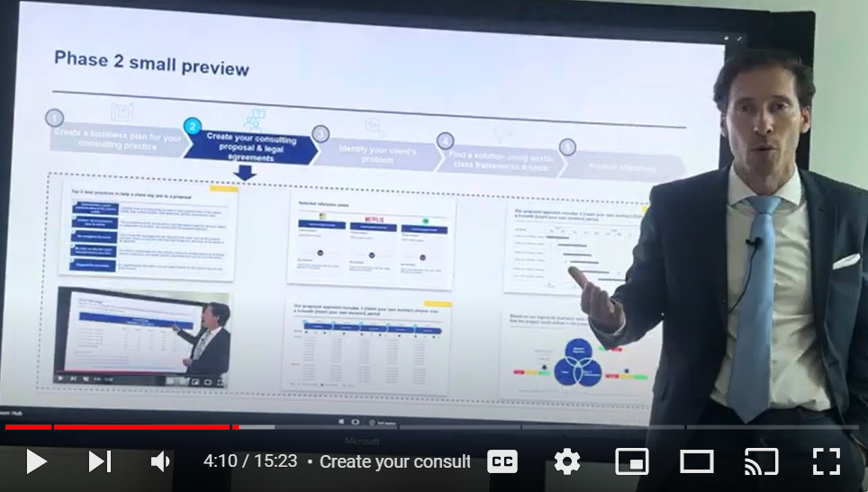
Video demonstration of the Management Consulting Toolkit
Video Demo Access
Video Demo Visual
Select “Slide Show” mode and then click on the link below or on the image on the right to access this video demo.
You can also access the video by copy pasting the following URL in your browser:
https://youtu.be/m7ezNzgr1vA

Slide 7





The Toolkit includes a 5-phase approach that we have built and refined over the past 20 years through constant trial and error
1
2
3
4
5
Create a business plan for your consulting practice
Create your consulting proposal & legal agreements
Identify your client’s problem
Find a solution using world-class frameworks & tools
Present effectively
Business Plan Canvas
Problem to Solve & Solution
Mission, Vision & Values
Strategic Objectives
Market Analysis
Competitor Analysis
Marketing Plan
Business Structure
Financial Plan
Business Valuation
Next Steps
Consulting proposal
Situation and key challenge
Proposed solution
Business case and financial model
Approach
Our value proposition
Proposed team
Consulting fees
Next steps
Legal agreements
Business consultant agreement
Non-disclosure agreement
Non-compete agreement
Internal analysis
Financial analysis
HR analysis
Marketing analysis
Customers analysis
Suppliers analysis
Market analysis
Target market
Market sizing with TAM
Market attractiveness with Porter’s 5 Forces
Environment analysis with PESTLE
Competitor analysis
Competitor identification
Benchmarking
Strategic group mapping
Competitor profiling
Problem identification tools
Issue tree
Five whys
Fishbone diagram
Problem definition worksheet
SWOT summary
Frameworks to answer common strategic questions
What caused the company’s profit to decrease?
Should we enter a new market?
Should we introduce a new product?
Should we acquire this company?
BU/Product portfolio management tools:
GE-McKinsey Matrix
BCG Growth-Share Matrix
Growth strategy tools
7 Degrees of Freedom for Growth
Ansoff Growth Matrix
Blue Ocean Strategy
McKinsey Seven-S
Porter’s Generic Corporate Strategies
Product Life Cycle
Other tools & frameworks
Value chain analysis
Value Driver Tree
Pareto Principle
Etc.
Presentation structure
Situation, complication and question
Pyramid principle
Storyboard
Top 300 ready-made consulting diagrams and charts
Business roadmaps
Conceptual charts
Dashboards
Editable maps
Funnel diagrams
Logical & decision trees
Matrix
Organizational charts
Process maps
Project plans, timelines & Gantt charts
Speedometer charts
Tables
Virtuous cycle charts
Waterfall charts
Etc.

Slide 8




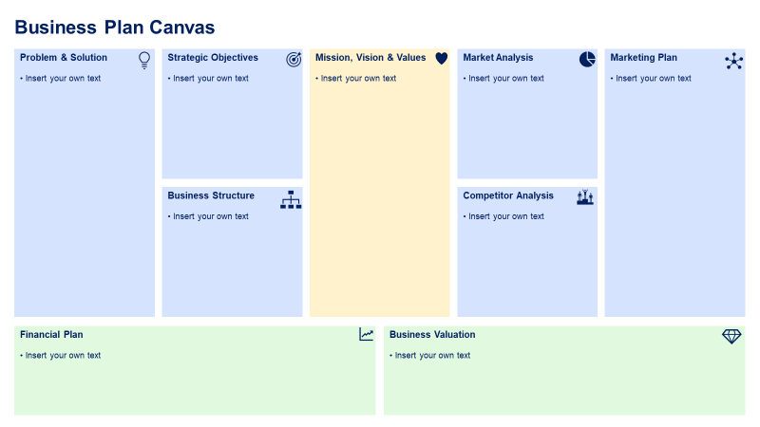
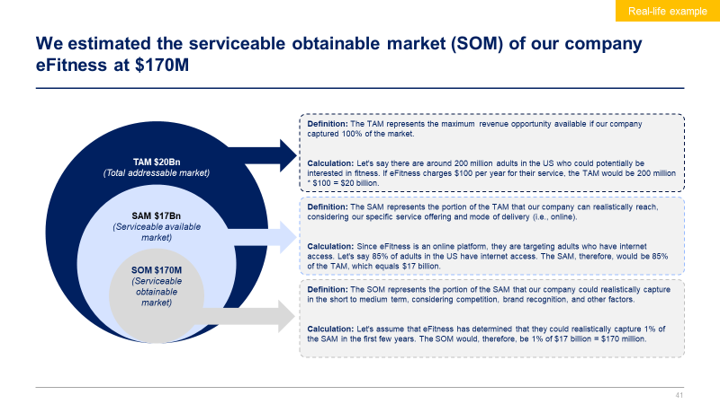
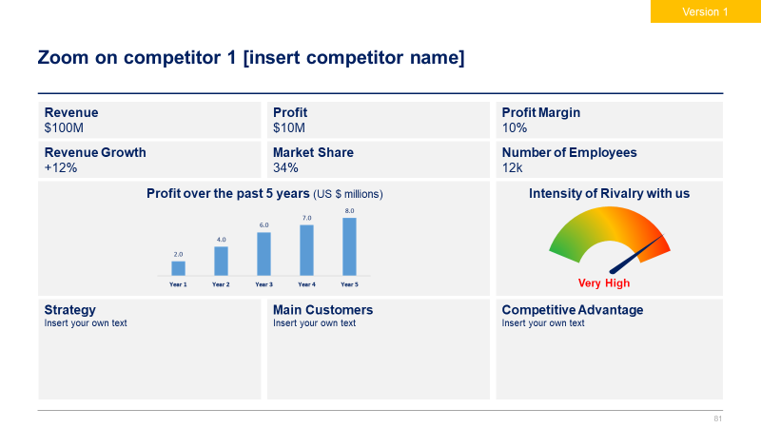
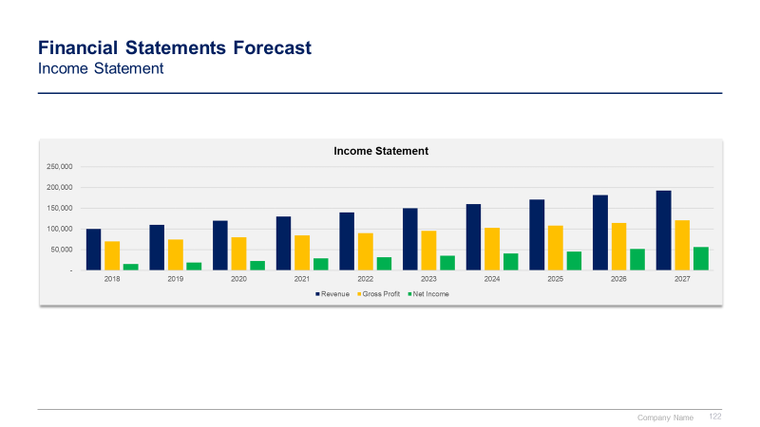
Phase 1 small preview
1
2
3
4
5
Create a business plan for your consulting practice
Create your consulting proposal & legal agreements
Identify your client’s problem
Find a solution using world-class frameworks & tools
Present effectively

Slide 9

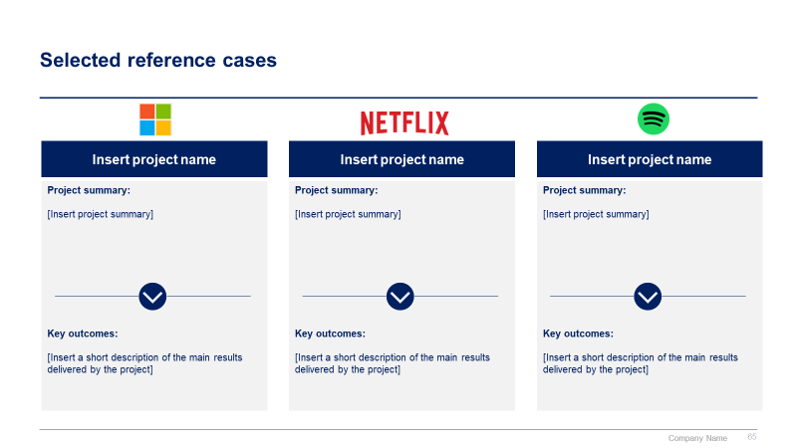
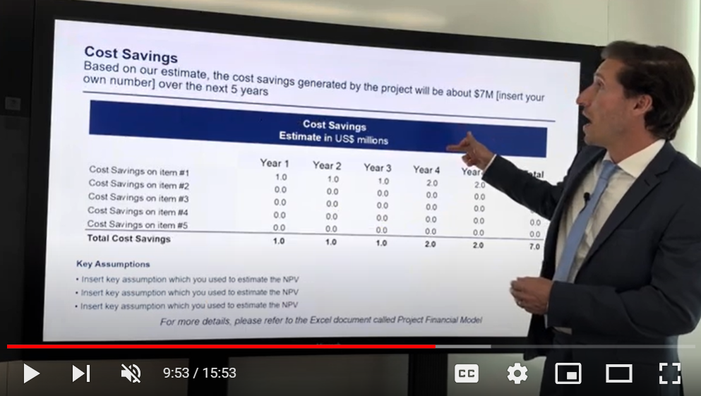
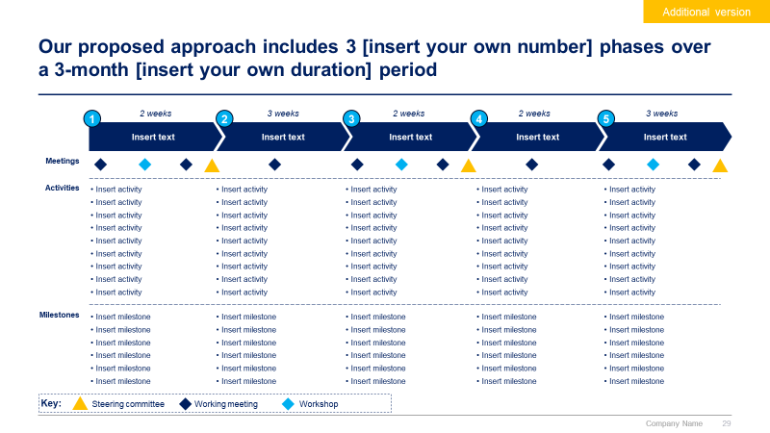
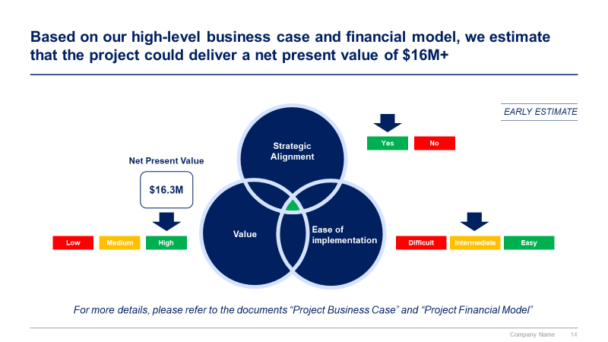
Phase 2 small preview
1
2
3
4
5
Create a business plan for your consulting practice
Create your consulting proposal & legal agreements
Identify your client’s problem
Find a solution using world-class frameworks & tools
Present effectively

Slide 10
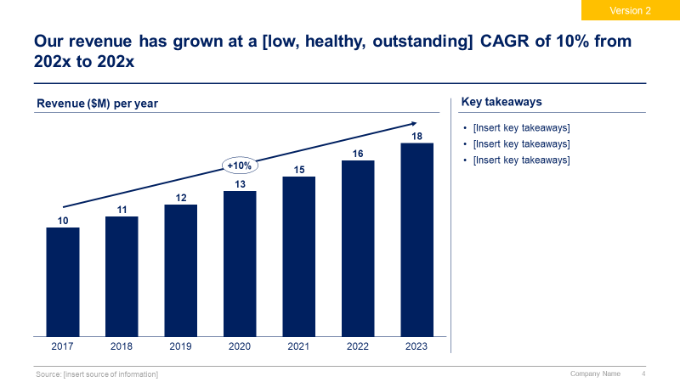
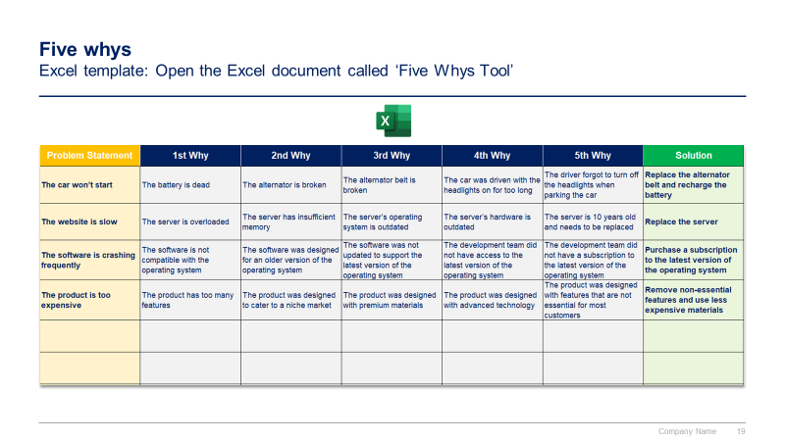
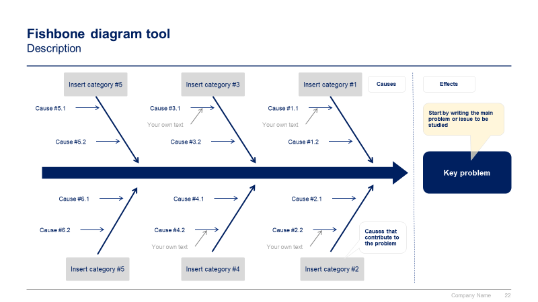
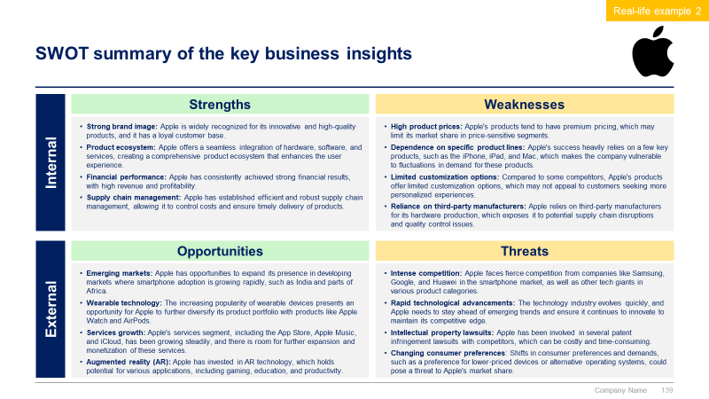
Phase 3 small preview
1
2
3
4
5
Create a business plan for your consulting practice
Create your consulting proposal & legal agreements
Identify your client’s problem
Find a solution using world-class frameworks & tools
Present effectively

Slide 11
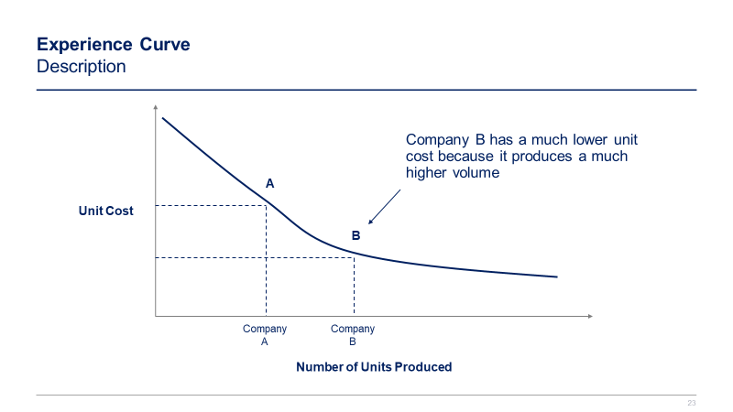
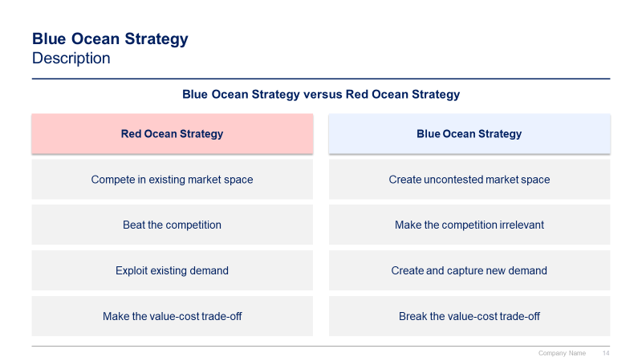
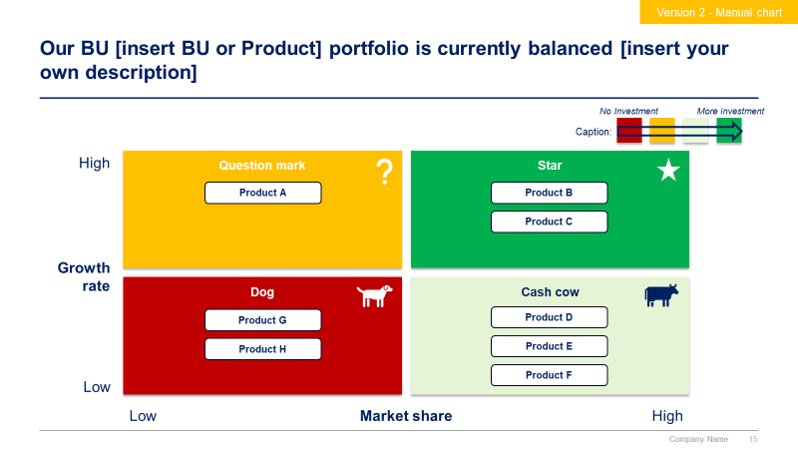
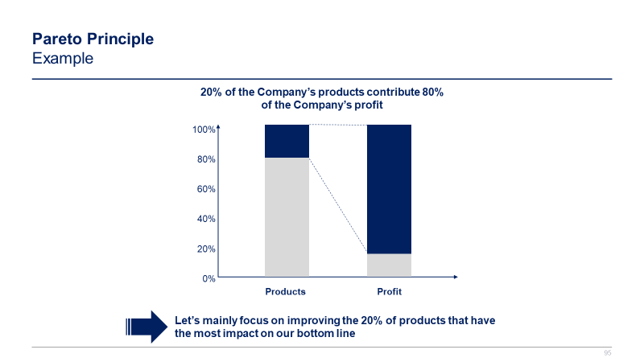
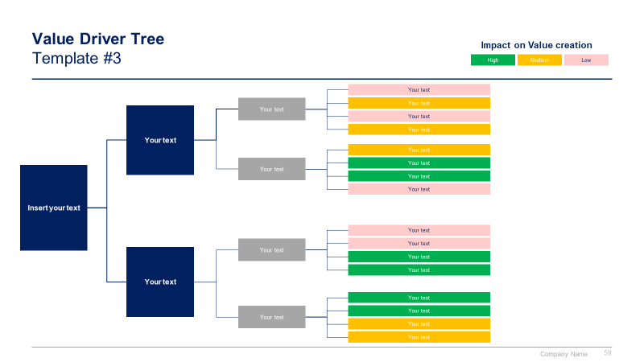
Phase 4 small preview
1
2
3
4
5
Create a business plan for your consulting practice
Create your consulting proposal & legal agreements
Identify your client’s problem
Find a solution using world-class frameworks & tools
Present effectively

Slide 12
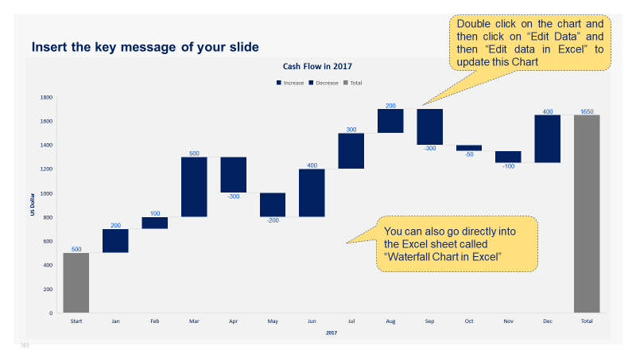
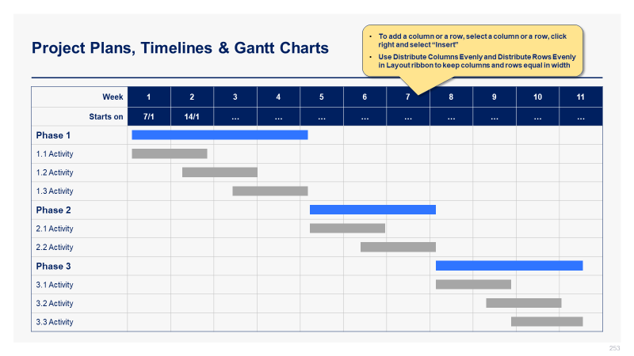
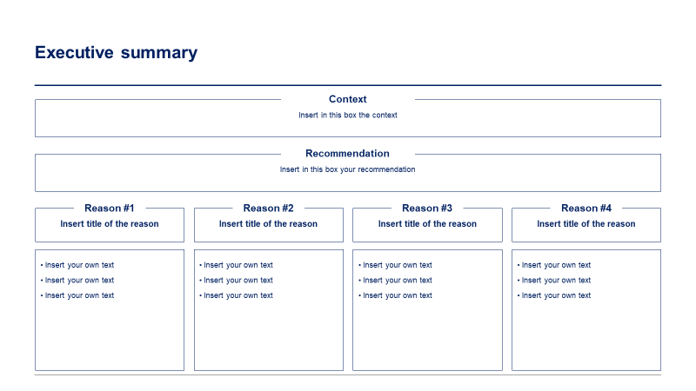
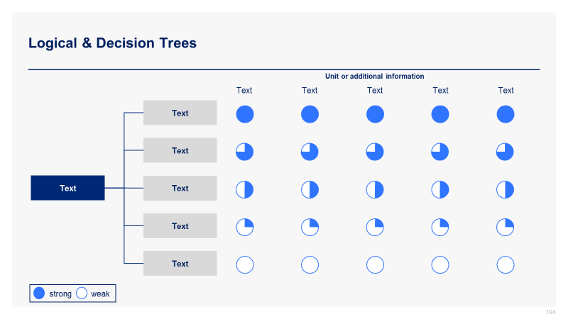
Phase 5 small preview
1
2
3
4
5
Create a business plan for your consulting practice
Create your consulting proposal & legal agreements
Identify your client’s problem
Find a solution using world-class frameworks & tools
Present effectively

Slide 13
In the next slides, you’ll see more content from the Management Consulting Toolkit
1
2
3
4
5
Create a business plan for your consulting practice
Create your consulting proposal & legal agreements
Identify your client’s problem
Find a solution using world-class frameworks & tools
Present effectively
Business Plan Canvas
Problem to Solve & Solution
Mission, Vision & Values
Strategic Objectives
Market Analysis
Competitor Analysis
Marketing Plan
Business Structure
Financial Plan
Business Valuation
Next Steps
Consulting proposal
Situation and key challenge
Proposed solution
Business case and financial model
Approach
Our value proposition
Proposed team
Consulting fees
Next steps
Legal agreements
Business consultant agreement
Non-disclosure agreement
Non-compete agreement
Internal analysis
Financial analysis
HR analysis
Marketing analysis
Customers analysis
Suppliers analysis
Market analysis
Target market
Market sizing with TAM
Market attractiveness with Porter’s 5 Forces
Environment analysis with PESTLE
Competitor analysis
Competitor identification
Benchmarking
Strategic group mapping
Competitor profiling
Problem identification tools
Issue tree
Five whys
Fishbone diagram
Problem definition worksheet
SWOT summary
Frameworks to answer common strategic questions
What caused the company’s profit to decrease?
Should we enter a new market?
Should we introduce a new product?
Should we acquire this company?
BU/Product portfolio management tools:
GE-McKinsey Matrix
BCG Growth-Share Matrix
Growth strategy tools
7 Degrees of Freedom for Growth
Ansoff Growth Matrix
Blue Ocean Strategy
McKinsey Seven-S
Porter’s Generic Corporate Strategies
Product Life Cycle
Other tools & frameworks
Value chain analysis
Value Driver Tree
Pareto Principle
Etc.
Presentation structure
Situation, complication and question
Pyramid principle
Storyboard
Top 300 ready-made consulting diagrams and charts
Business roadmaps
Conceptual charts
Dashboards
Editable maps
Funnel diagrams
Logical & decision trees
Matrix
Organizational charts
Process maps
Project plans, timelines & Gantt charts
Speedometer charts
Tables
Virtuous cycle charts
Waterfall charts
Etc.

Slide 14
The profit across all BUs has been increasing over the past 5 years [insert your own text]
BU 1 Profit ($M)
BU 2 Profit ($M)
BU 3 Profit ($M)
BU 4 Profit ($M)

Slide 15
We decided to use the BCG matrix to help us better understand our current BU [if needed, replace BU by product] portfolio (1/2)
The BCG Growth-Share Matrix, also known as the Boston Consulting Group Matrix, is a portfolio management tool that helps companies decide how to prioritize their different businesses. The matrix is split into four quadrants, each with its own unique symbol that represents a certain degree of profitability: question marks, stars, pets (often represented by a dog), and cash cows. By assigning each business to one of these four categories, executives could then decide where to focus their resources and capital to generate the most value, as well as where to cut their losses.
The matrix was created in 1968 by Bruce Henderson, the founder of BCG. It was built on the logic that market leadership results in sustainable superior returns. Ultimately, the market leader obtains a self-reinforcing cost advantage that competitors find difficult to replicate. These high growth rates then signal which markets have the most growth potential.
Each of the four quadrants represents a specific combination of relative market share and market growth rate:
Low Growth, High Share: Companies should milk these “cash cows” for cash to reinvest.
High Growth, High Share: Companies should significantly invest in these “stars” as they have high future potential.
High Growth, Low Share: Companies should invest in or discard these “question marks,” depending on their chances of becoming stars.
Low Share, Low Growth: Companies should liquidate, divest, or reposition these “pets.”
The matrix reveals two factors that companies should consider when deciding where to invest: company competitiveness and market attractiveness, with relative market share and growth rate as the underlying drivers of these factors.
The BCG Growth-Share Matrix is still central in business school teachings on business strategy and has been used by about half of all Fortune 500 companies.

Slide 16



We decided to use the BCG matrix to help us better understand our current BU [if needed, replace BU by product] portfolio (2/2)
No Investment
More investment
Caption:
High
Question mark
Description: High growth but neutral or negative cash flow (expensive growth)
Strategy: See if ROI can be improved
Star
Description: Growing earnings, positive or neutral cash flow
Strategy: Invest in growth
Growth rate
Dog
Description: Small market share in low growth market, requires much capital to continue
Strategy: Divest or close
Cash cow
Description: Stable earnings and solid cash flow, low growth business
Strategy: Milk for remaining value
Low
Low
Market share
High

Slide 17
Our BU [insert BU or Product] portfolio is currently balanced [insert your own description]
Version 1 - Automated chart
Growth rate (201x-202x)
Size = Annual revenue ($M) in 202x
BU2
BU1
BU3
BU4
BU6
BU5
Market share (202x)

Slide 18
Our BU [insert BU or Product] portfolio is currently balanced [insert your own description]
Version 2 - Manual chart
No Investment
More investment
Caption:
High
Question mark
Star
Product A
Product B
Product C
Growth rate
Dog
Cash cow
Product G
Product D
Product H
Product E
Product F
Low
Low
Market share
High

Slide 19
In 202x, the Product B was the main contributor to our total revenue and profit
Revenue ($M), 202x
Profit ($M), 202x
Product A
Product C
Product D
Product B
Total
Product A
Product C
Product D
Product B
Total
Source: [insert source of information]

Slide 20
McKinsey’s 7 Degrees of Freedom for Growth Description (1/2)
McKinsey's 7 Degrees of Freedom for Growth is a strategy tool that helps businesses understand which opportunities will contribute to expansion and prioritize those initiatives.
The seven degrees of freedom are as follows:
Selling existing products to existing customers: This is the first and most cost-effective strategy for a business.
Acquiring new customers in existing markets: While most businesses will argue that they know their target market, there are always new customers to be found.
Creating new products and services: This degree of freedom is about creating new products or services that can be sold to existing customers or new customers in existing markets.
Developing new value-delivery approaches: This degree of freedom is about finding new ways to deliver value to customers.
Moving into new geographies: This degree of freedom is about expanding into new geographic markets.
Creating a new industry structure: This degree of freedom is about creating a new industry structure that can support growth.
Opening up new competitive arenas: This degree of freedom is about finding new competitive arenas where the company can compete and win.
The seven degrees of freedom are not mutually exclusive, and companies can use most of them to achieve growth. McKinsey's research shows that the best companies consider these seven distinct strategic degrees of freedom and use most of them. The staircase approach of continuously compounding skills and options is consistent with the competitive reality of most industries, where building a staircase explicitly recognizes that the appropriate strategy for any company depends on where it is today and on the state of the world down the road.

Slide 21

McKinsey’s 7 Degrees of Freedom for Growth Description (2/2)
7
6
Opening new competitive arenas
5
Creating a new industry structure
4
Geographical expansion
3
Developing new value-delivery approaches
2
Creating new products and services
1
Acquiring new customers in existing markets
Selling existing products to existing customers

Slide 22
McKinsey’s 7 Degrees of Freedom for Growth Step-by-step tutorial
1
Understand the seven degrees of freedom and what they entail.
2
Identify where your business currently stands in terms of the seven degrees of freedom. This will help you determine which degrees of freedom you should focus on first
3
Determine which growth opportunities are available to you. This can be done by analyzing your current market and identifying areas where you can expand
4
Prioritize your initiatives. This can be done by assessing the potential impact of each initiative and determining which ones will have the greatest impact on your business
5
The final step is to develop an action plan that outlines how you will achieve your growth objectives. This should include specific steps that need to be taken, timelines for each step, and metrics for measuring success

Slide 23
McKinsey’s 7 Degrees of Freedom for Growth Real-life example: By using all seven degrees of freedom, Disney has been able to achieve significant growth over the years.
7
6
Disney has opened up new competitive arenas by entering the streaming market with Disney+
5
Disney has created a new industry structure by acquiring Marvel and Lucasfilm
4
Disney has moved into new geographies by opening theme parks in Shanghai and Hong Kong
3
Disney has developed new value-delivery approaches by offering personalized experiences at its theme parks
2
Disney has created new products and services by launching Disney+, its streaming service
1
Disney has also acquired new customers in existing markets by expanding its theme parks and cruise lines
Disney has sold existing products to existing customers by releasing sequels to popular movies, such as Toy Story 2

Slide 24
McKinsey’s 7 Degrees of Freedom for Growth Template #1
Selling existing products to existing customers by [insert your own text]
1
Acquiring new customers in existing markets by [insert your own text]
2
Creating new products and services by [insert your own text]
3
Developing new value-delivery approaches by [insert your own text]
4
Geographical expansion by [insert your own text]
5
Creating a new industry structure by [insert your own text]
6
Opening new competitive arenas by [insert your own text]
7

Slide 25
McKinsey’s 7 Degrees of Freedom for Growth Template #2
7
6
Opening new competitive arenas by [insert your own text]
5
Creating a new industry structure by [insert your own text]
4
Geographical expansion by [insert your own text]
3
Developing new value-delivery approaches by [insert your own text]
2
Creating new products and services by [insert your own text]
1
Acquiring new customers in existing markets by [insert your own text]
Selling existing products to existing customers by [insert your own text]

Slide 26



The Toolkit includes multiple PowerPoint slides, Excel sheets and Video training that you can download on your device immediately after purchase
900 editable PowerPoint slides*
62 Excel sheets*
71 minutes of Video training
10 Word pages
*Please note that the number of Powerpoint slides and Excel sheets listed is the number of unique slides and sheets. For example, a Powerpoint slide that has been duplicated to facilitate our clients’ understanding only counts for one slide

Slide 27









Our Management Consulting Toolkits include 9 key benefits
Improve the growth & efficiency of your organization by leveraging Management Consulting Toolkits created by ex-McKinsey, Deloitte & BCG Consultants.
Make a great investment for your career & organization. It cost us US$8M+ over the past 10 years to create all our Toolkits. Get them for a fraction of this cost.
Get a competitive advantage. It’s like hiring Management Consultants to create all the practical Frameworks, Tools & Templates you need.
Get the job done quicker and never start from scratch again with our ready-made and fully editable Frameworks, Tools & Templates in Powerpoint & Excel.
Don't reinvent the wheel. We have already worked 30,000+ hours over the past 10 years to create all the Management Consulting Toolkits you need.
Improve the capabilities of your organization by learning how the Fortune 100 and Global Consulting Firms do it.
Decrease your costs. Hiring tier-1 Consultants for a project would cost you $300k+. Way more expensive than our Toolkits, which will last you a lifetime!
Become your organization’s subject matter expert and impress your stakeholders with world-class approaches to resolve common business problems.
Get free support and advice from our ex-McKinsey, Deloitte & BCG Management Consultants.

Slide 28
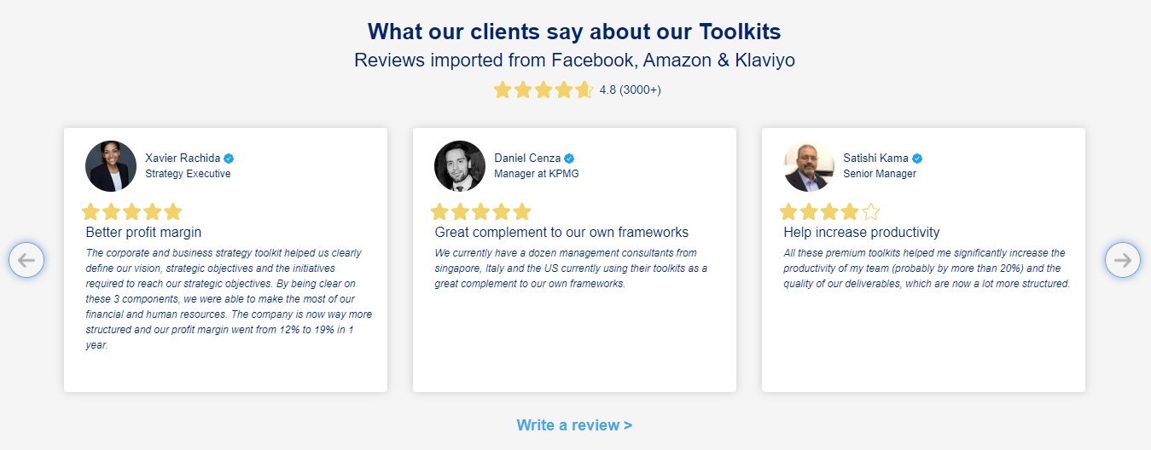
What our clients say about our Toolkits
Click here to see more reviews >

Slide 29

Join 200,000+ Executives, Consultants & Entrepreneurs leveraging our Toolkits to improve the performance of their organization
Trusted by small and large organizations
Customer satisfaction
4.8
Number of countries leveraging our Toolkits
160+
Number of professionals leveraging our Toolkits
200,000+
Daily rate of our ex-McKinsey, Deloitte and BCG Management Consultants
$3k-$4k

Slide 30

Interested in more than 1 Toolkit? Access all our Toolkits for half the price with our Gold Access
Gold Access
Click here to learn more

Slide 31
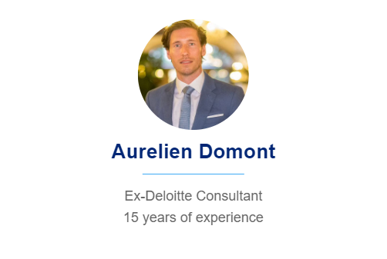

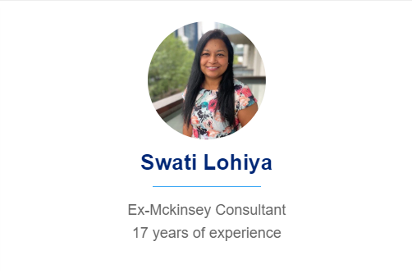
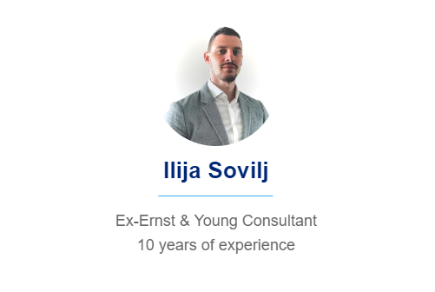
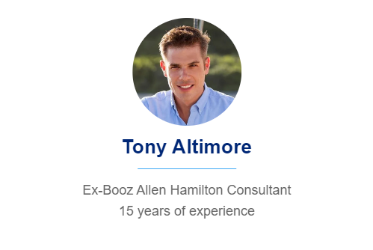
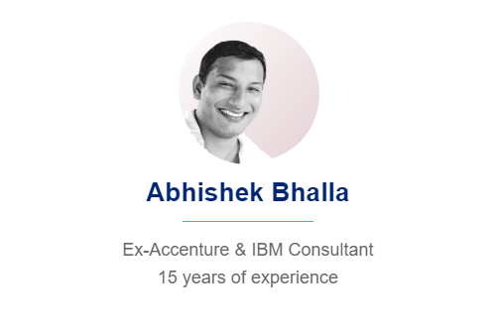
Need additional help? Send us a brief and we’ll find you the right talent from our network of 500+ tier-1 Management Consultants
Click here to send us a Project Brief

Slide 32
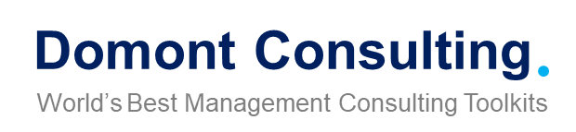
This was just a small preview.
www.domontconsulting.com

